Slide 1

Lecture-3
Javascript String

Slide 2
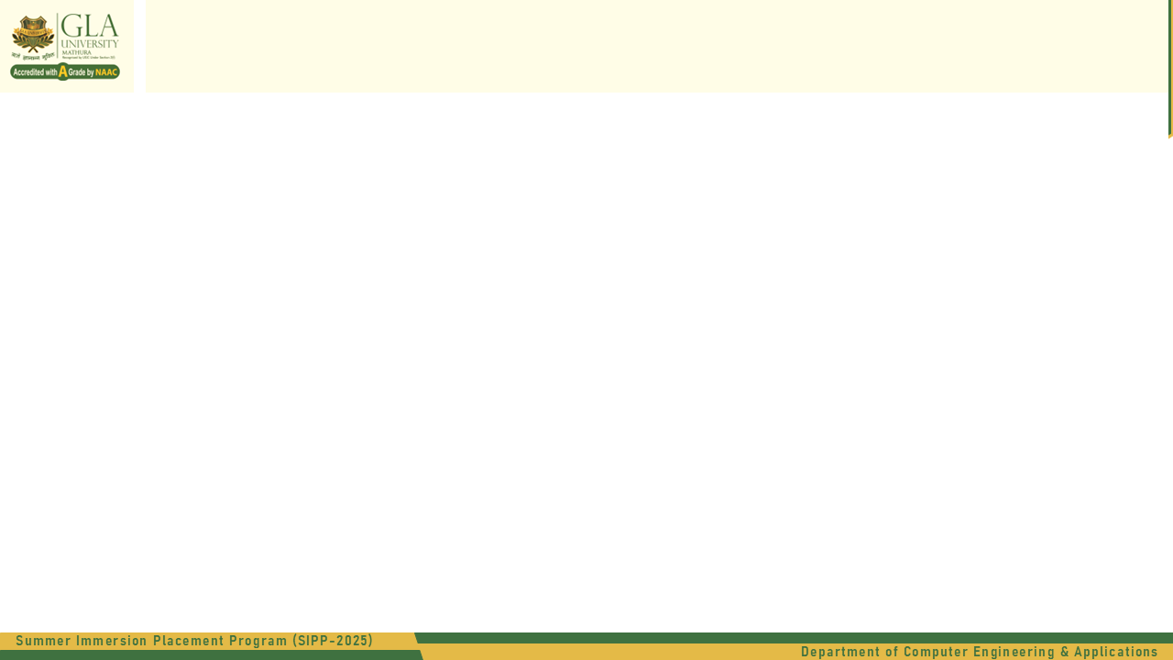
JavaScript String
What i a String?
A string is a sequence of characters used to represent text.
To find the length of the string:
let str = "JavaScript";
console.log(str.length); // 10

Slide 3
Operations of JavaScript String
Operations | Description | Example
toUpperCase() | Converts to uppercase | "hello".toUpperCase() → "HELLO"
toLowerCase() | Converts to lowercase | "HELLO".toLowerCase() → "hello"
charAt(index) | Returns the character at a specific index | "JS".charAt(1) → "S"
indexOf(value) | Returns first occurrence index | "banana".indexOf("a") → 1
lastIndexOf(value) | Returns last occurrence index | "banana".lastIndexOf("a") → 5
includes(value) | Checks if substring exists | "JavaScript".includes("Script") → true
startsWith(value) | Checks if string starts with given text | "Hello".startsWith("He") → true
endsWith(value) | Checks if string ends with given text | "Hello".endsWith("lo") → true

Slide 4
Coding Questions of String
1.Reverse a String
Given: “Hello World”
2. Count the Number of Vowels in a String
Given: “GLA University”
3. Check if a String is a Palindrome
Given: testcase1: “Hello”
testcase2: “racecar”
4. Convert the First Letter of Each Word to Uppercase Given: “hello world”
5. Find the First Non-Repeated Character
Given: “aabbccccdee”

